Slide 1
Work Progress
By: Abdur Rehman

Slide 2
Model Training and Evaluation
df
Out[2]:
input_signal
0 0.0
1 1.0
2 1.0
3 1.0
4 1.0
...
2996 0.0
2997 0.0
2998 0.0
2999 0.0
3000 0.0
[3001 rows x 1 columns]
Input used CAin as Pandas’ Dataframe as df:
df.shape:
df.shape
Out[3]: (3001, 1)
Output used as Pandas’ Dataframe for the three states as
dataFrame_Output:
dataFrame_Output.shape:
dataFrame_Output.shape
Out[6]: (3001, 3)
To have a larger dataset for the input and output, the simulation was
Increased to 3001 including the initial state to:
x0 = DM([0.2, 0.3, 0.1])
dataFrame_Output
Out[5]:
0 1 2
0 2.000000e-01 3.000000e-01 1.000000e-01
1 2.000000e-01 4.384874e-01 2.722606e-01
2 2.000000e-01 4.678919e-01 3.121932e-01
3 2.000000e-01 4.743036e-01 3.212528e-01
4 2.000000e-01 4.757272e-01 3.232813e-01
... ... ...
2996 5.546383e-21 1.233850e-04 2.403725e-08
2997 2.769604e-24 2.753471e-05 1.197054e-09
2998 1.077281e-26 6.144180e-06 5.960255e-11
2999 7.698021e-27 1.371159e-06 2.968697e-12
3000 -4.212175e-26 3.050660e-07 1.466714e-13
[3001 rows x 3 columns]

Slide 3
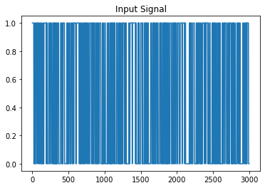
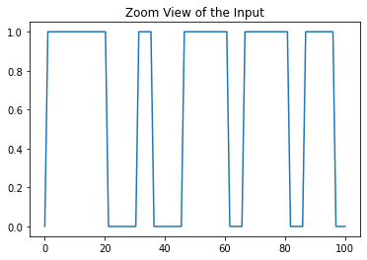
The new set of inputs observed in the form
of a graph of 3001 values:
To have Zoom view of the input to observe as a human:

Slide 4
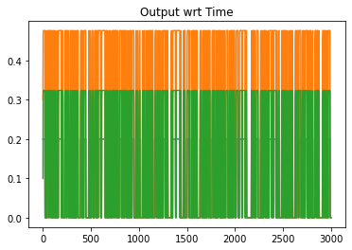
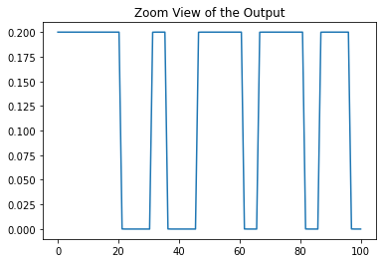
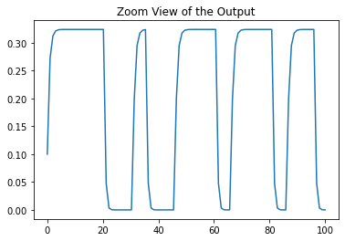
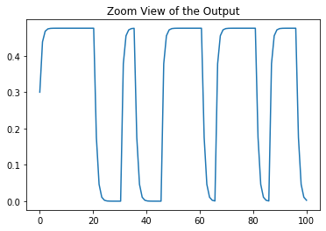
The new set of outputs observed in the form
of a graph of 3001 values wrt Time elapsed:
To have Zoom view of the Output (Each States) to observe
as a human:

Slide 5
Implementation of a Dynamic Neural Network: LONG SHORT-TERM MEMORY
Introduction to LONG SHORT-TERM MEMORY:
Long short-term memory (LSTM) is an artificial recurrent neural network (RNN) architecture used in the field of deep learning.
LSTM has feedback connections.
A common LSTM unit is composed of a cell, an input gate, an output gate and a forget gate.
LSTMs were developed to deal with the vanishing gradient problem that can be encountered when training traditional RNNs.

Slide 6
Step I:
Import the libraries and modules
from keras.layers import LSTM
from tensorflow.keras.optimizers import Adam
from keras.models import Sequential
from keras.layers import Dense
Step II:
Set the training and validation set of data for the input and output:
X_train = df.iloc[:2000]
X_test = df.iloc[2000:]
dataFrame_Output = pd.DataFrame(sliced_data_withZero)
y_train = dataFrame_Output.iloc[:2000]
y_test = dataFrame_Output.iloc[2000:]
Step III:
Initializing the Neural Network
model = Sequential()

Slide 7
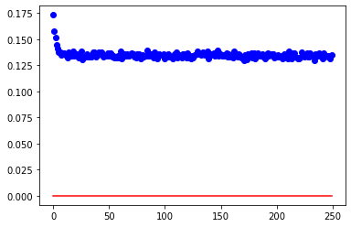
Step IV:
Setting up the Long Short-Term Memory layers:
model.add(LSTM(3, input_shape=(2000,1),return_sequences=True))
model.add(Dense(3,))
model.compile(loss='mean_absolute_error', optimizer='adam',metrics=['accuracy’])
Step V:
Fitting the model and storing the model in the variable named “history”:
history = model.fit(X_train, y_train, epochs=250, batch_size=5, verbose=2,validation_data=(X_test, y_test))
Step VI:
Evaluating the LSTM model of 250 Epochs and the batch size of 5
Loss (red) and accuracy plot(blue):

Slide 8
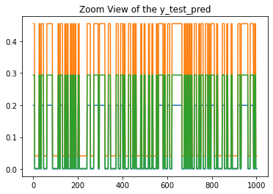
Step VII:
Using the test set of the data to predict the output from the model generated:
predict = model.predict(X_test)
predict = predict.reshape(-1, 3) #reshaped it to be able to calculate
Predicted Output stored in the variable “predict”:
predict.shape
Out[17]: (1001, 3)
Predicted Output with respect to Time:
predict
Out[14]:
array([[0.19944331, 0.45377946, 0.29362184],
[0.19944331, 0.45377946, 0.29362184],
[0.19944331, 0.45377946, 0.29362184],
...,
[0.0008612 , 0.04175196, 0.00255095],
[0.0008612 , 0.04175196, 0.00255095],
[0.0008612 , 0.04175196, 0.00255095]], dtype=float32)

Slide 9
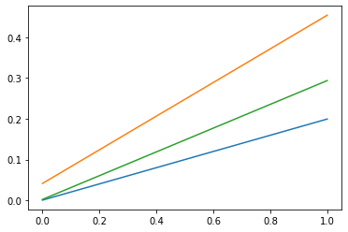
Predicted Output with respect to Input:
plt.plot(X_test, predict)
(Input is in X Axis and Output on Y Axis)
Tested Output stored in the variable “y_test”:
y_test.shape
Out[18]: (1001, 3)
y_test
Out[16]:
0 1 2
2000 2.000000e-01 0.476135 3.238642e-01
2001 2.000000e-01 0.476136 3.238644e-01
2002 2.000000e-01 0.476136 3.238644e-01
2003 2.000000e-01 0.476136 3.238644e-01
2004 2.000000e-01 0.476136 3.238644e-01
... ... ...
2996 1.106172e-04 0.175288 4.760787e-02
2997 6.120294e-08 0.046386 3.373891e-03
2998 3.388094e-11 0.010915 1.877692e-04
2999 1.875957e-14 0.002468 9.611498e-06
3000 1.027128e-17 0.000552 4.815832e-07
[1001 rows x 3 columns]

Slide 10
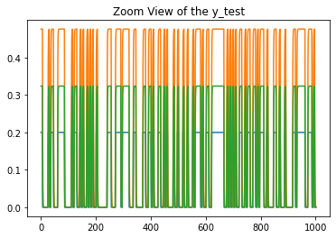
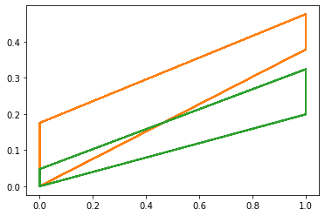
Tested Output with respect to Time:
Tested Output with respect to Input:
plt.plot(X_test, predict)
(Input is in X Axis and Output on Y Axis)

Slide 11
Evaluation of the Results
Finding the Mean Absolute Error:
from sklearn.metrics import mean_absolute_error
mean_absolute_error(y_test, predict)
Out[23]: 0.01849053016984571
Which is 1.85%
Checking the R2 Score:
from sklearn.metrics import r2_score
sklearn.metrics.r2_score(y_test, predict)
Out[24]: 0.9745004444393454
Which is 97.5%

Slide 12
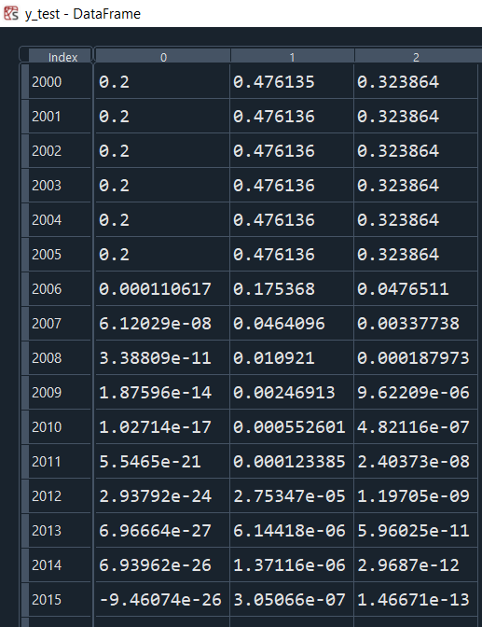
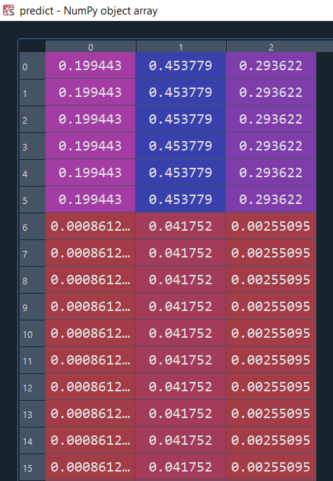
Comparison of the two data sets

